Slide 1

Sales Forecasting

Slide 2
Agenda
Objectives/ Problem Statement
Data Description
Exploratory Data Analysis
Making Time Series Nature Data
Random Forest Regression (Traditional ML)
LSTM Model (Deep Learning)
Conclusion

Slide 3
Objective - Sales Forecasting
Sales forecasting is the process of estimating future sales for a business based on historical data and market trends. It plays a crucial role in the overall planning process of any business as it helps to determine the resources needed to achieve sales targets and make informed decisions on inventory, production, and staffing
Helps in strategic planning and setting realistic sales goals.
Facilitates in identifying potential challenges and opportunities for growth.
Enables businesses to make informed decisions regarding resource allocation.
Improves cash flow management by forecasting revenue and expenses.
Helps in identifying areas of inefficiencies and ways to improve performance.
Enables businesses to respond proactively to market changes and competitive pressures.

Slide 4
Data Description
We have used sales data of previous years (more previous years, best will be forecasting – historic data)
We have calculated sales for each country, region, model family, model name, model year and model CC engine
We have around 5300 records and 7 columns
We have used features - 'Country US or Not?', 'Sale Region Code', 'Family Name', 'Model Name', 'Model Year', 'Engine CC Size‘
We have used sales data from 2004 till 2022 – The data was only available from 2004 to 2009 and most the sales were 0 for many models – for this POC purpose I have plot random sales for years where sales is ZERO (random value between 1 and 200

Slide 5
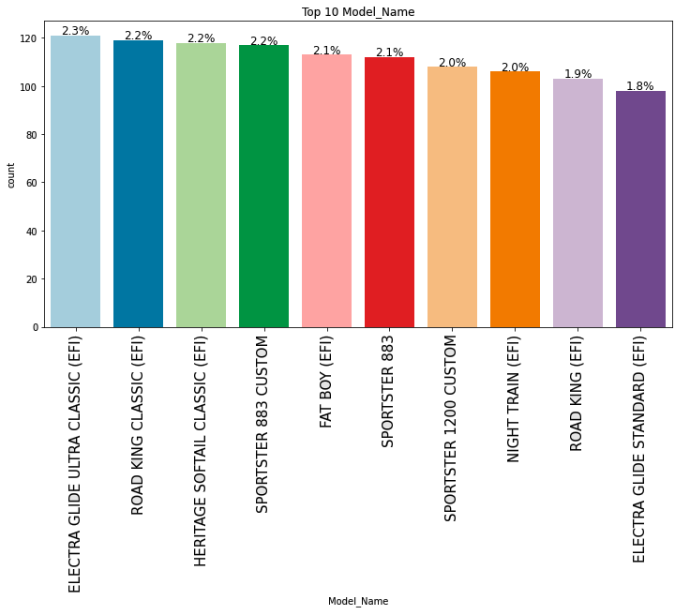
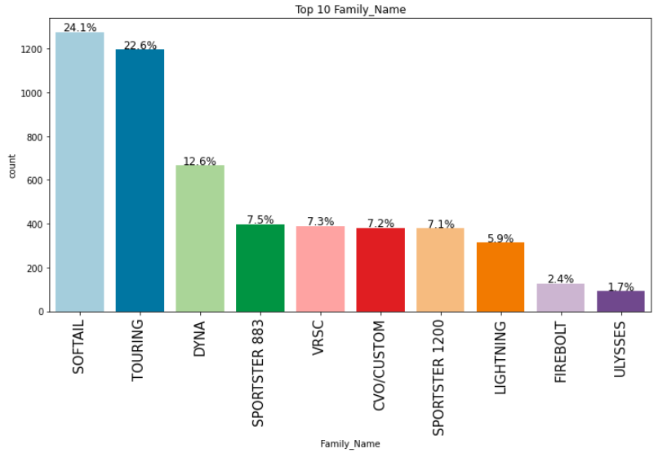
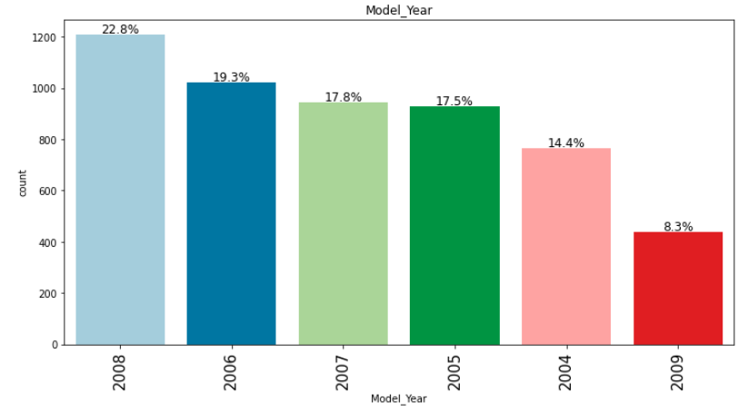
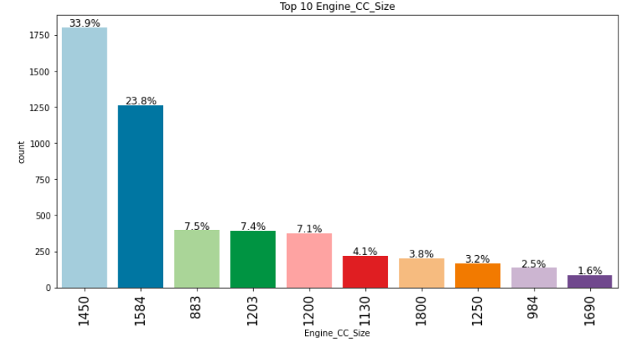
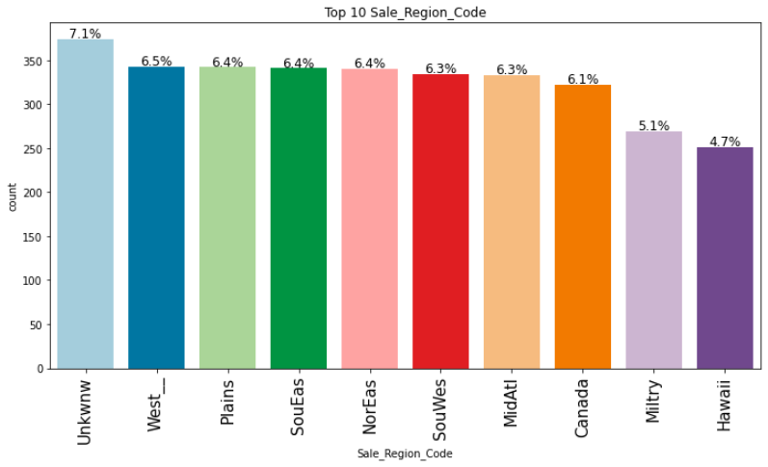
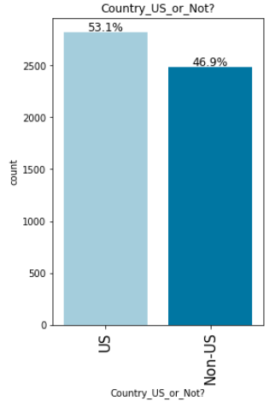
Exploratory Data Analysis
Whether sales inside in US or outside US?
Top 10 Sales Regions
Top 10 Family Names
Top 10 Model Names
Model Year Wise Data
Engine Size Wise Data

Slide 6
Making Data as Time Series Nature
Dataset
Time Series Dataset
Day 1 Sale
Day 1 Sale
Day 2 Sale
Day 3 Sale
Day 2 Sale
Day 2 Sale
Day 3 Sale
Day 4 Sale
Day 3 Sale
Day 3 Sale
Day 4 Sale
Day 5 Sale
Day 4 Sale
Day 5 Sale
Day 6 Sale
X - Predictor
y - Target
Loop back: How many previous records are we considering for predicting next. Here loop back is 2, we predict next on basis of last two records
Day 7 Sale
Day 8 Sale

Slide 7
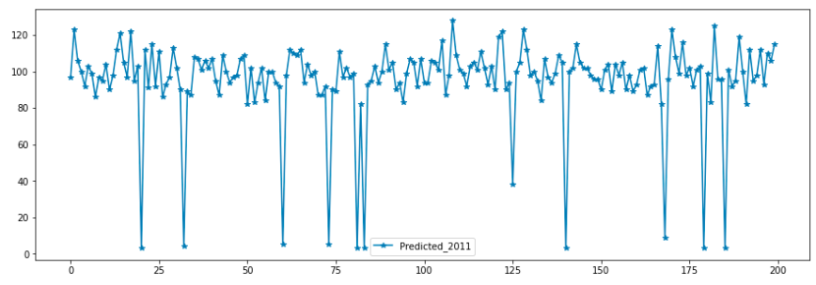
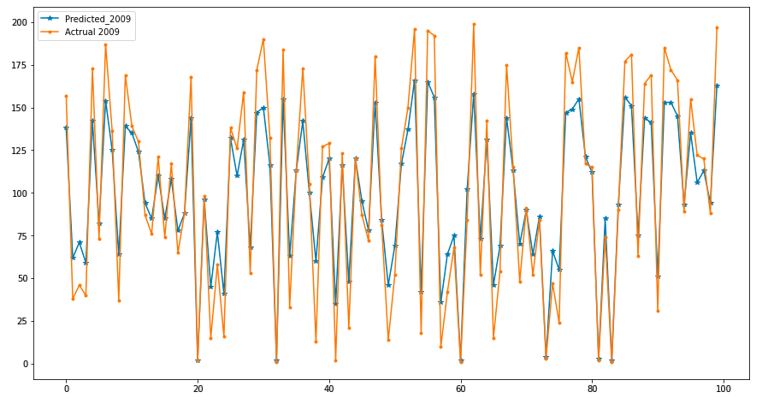
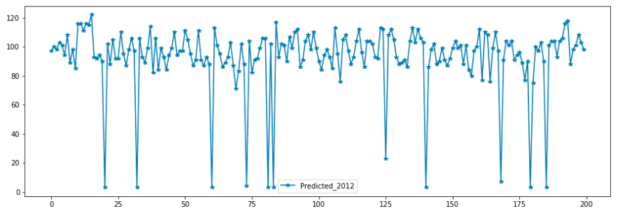
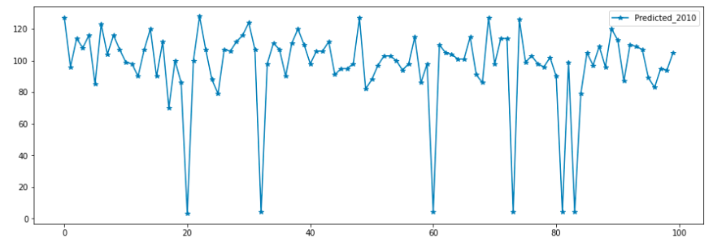
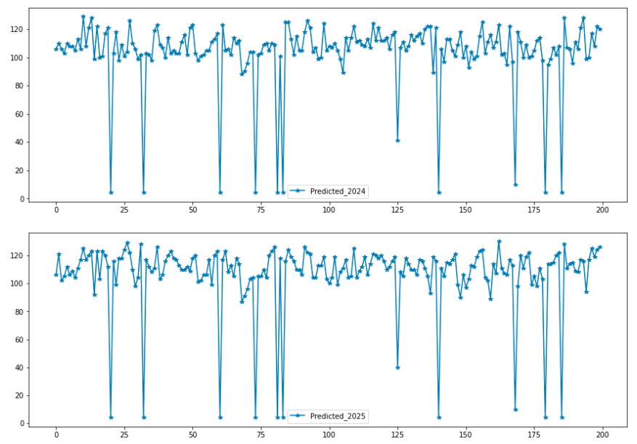
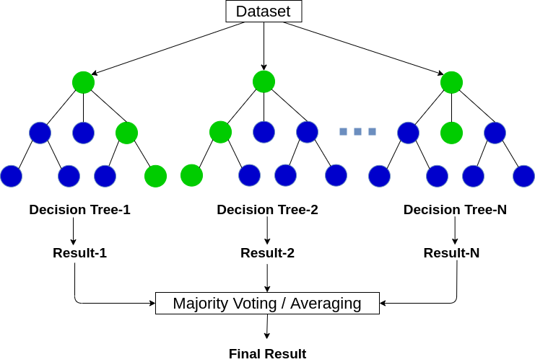
Random Forest Regression
We have used Time Series Data (Year Wise Sales) along with other features such as Model Family, Model Name, Model Year, Country and Engine Size
We have used 500 trees in Forest
Results were very effective
Forecasting for next years

Slide 8
Deep Learning – LSTM Model
LSTM (Long Short-Term Memory) is a type of Recurrent Neural Network (RNN) architecture that is capable of processing sequential data such as time series. It was introduced by Hochreiter & Schmidhuber in 1997 to address the problem of vanishing gradients in traditional RNNs. LSTM uses a memory cell that can selectively forget or remember information over time, allowing it to capture long-term dependencies in the data.
LSTM is particularly effective for time series because it can handle inputs with varying time intervals and can capture both short-term and long-term temporal dependencies. It can also handle input sequences of variable length, making it useful for time series data with irregular sampling intervals. Additionally, LSTM can model non-linear relationships in time series data, making it a powerful tool for forecasting future values based on past observations.

Slide 9
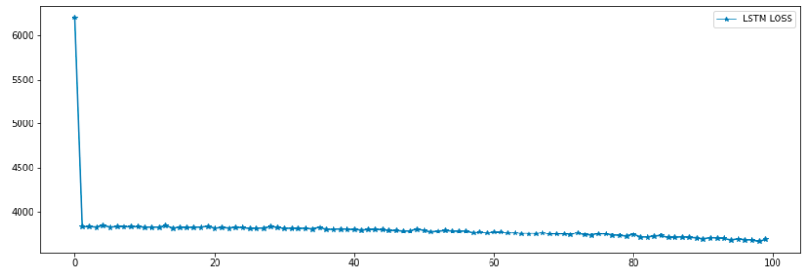
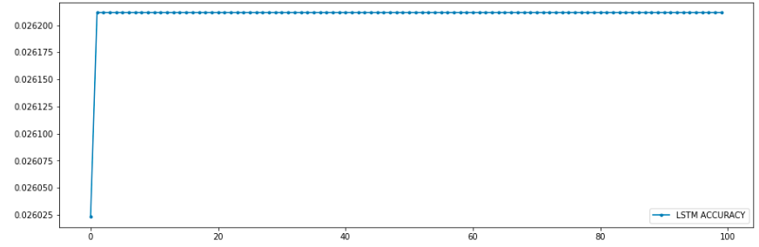
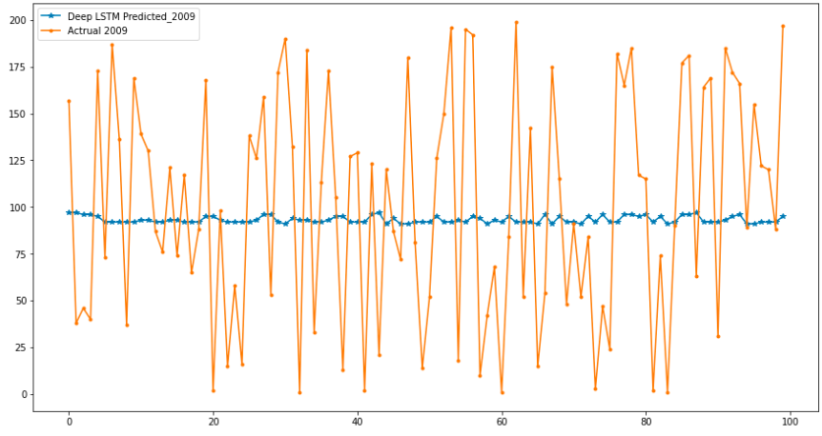
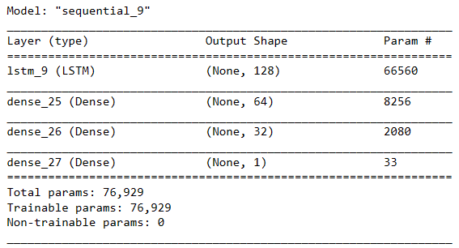
Deep Learning – LSTM Model
We have used this LSTM Network
The results are not good because
We have small amount of data
We have small network
We have used less iteration
We haven’t tune parameters
LSTM Loss
LSTM Accuracy

Slide 10

Conclusion
Sales forecasting is an important tool for businesses to plan and make strategic decisions. It provides insights into future sales trends, helps in inventory management, and facilitates better decision-making. By analyzing historical data and current trends, businesses can make accurate sales forecasts, which can help them stay competitive in the market.
We have successfully applied random forest regressor and LSTM on the dataset to forecasted sales for next years. The Random Forest is performing very good, but LSTM due to small amount of data is not good.
The weak performance is due to small amount of data.
Sales forecasting helps us to design strategies and effective planning ahead

Slide 11
Thank you

